Slide 1
Gender by Design
Helena Morrissey, Chairwoman, The Diversity Project
Rachel Harris, Head of Credit and Equity Investment Specialists, Aviva Investors and Lead of the DP Returners workstream

Slide 2
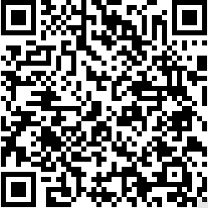
How can we achieve the 5-year gender goals?
 | Two reasonable goals
 | 1. 20% female fund managers
 | 2. Reducing 2019 gender pay gaps by a third
 | The reality is the goals look a stretch
 | The proportion of female fund managers has fallen to 11.2% from 14% 20 years ago
 | The gender pay gaps have narrowed slightly in Year 1
 | The plan: systematically create Gender Balance by Design

Slide 3
Cross-Company Returners Programme
In partnership with Women Returners
2020
2021
2022
9 hired into permanent roles
15 hired into permanent roles
5 participant firms
7 participant firms
8 participant firms signed up so far…
Time to get involved…
For more information and
to sign up, contact: info@diversityproject.com
11 Returners received placements
36% ethnically diverse
18 Returners received placements
55% ethnically diverse

