Slide 1
Welcome
Helena Morrissey
Chair, Diversity Project

Slide 2
Slides to follow – may include a polling question

Slide 3
An ever growing community

Slide 4
An ever growing community
OVER 400 VOLUNTEERS

Slide 5
A comprehensive set of initiatives with strong leadership
Ambassadors’ programme
Sarah Bates
Jayne Styles
Project Management
Jane Welsh
Charlotte Mason
Gender
Helena Morrissey
Cosmo Elms
#TalkAboutBlack
Gavin Lewis
Justin Onuekwusi
Dawid Konotey-Ahulu
Early career
Emma Douglas
Asset owners
Craig Rimmer
Metrics
Jo Livermore
Marketing/ PR
Linda Russheim
Lansons
Mental Health
Katy Halliday
LGBT+
Colette Comerford
Matt Cameron
Returners
Rachel Harris
Kirsty Baldock
Neurodiversity
Meike Bliebenicht
Military
Kelly Mullane
SMART Working
Ana Maria Tuliak
Disability
Tim Roberts
Alexandra Haggard
Dion McKenzie
Social Mobility
David Aujla
Working Families
Claire Black
Sascha Calisan
Light green provide support across the project, green are types of diversity, light blue are career stages, blue are asset owners

Slide 6
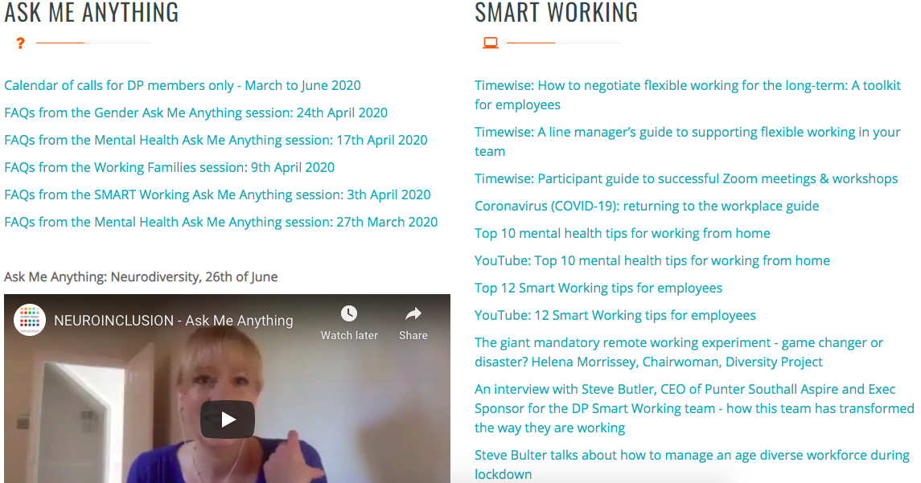
Covid – here to help

Slide 7
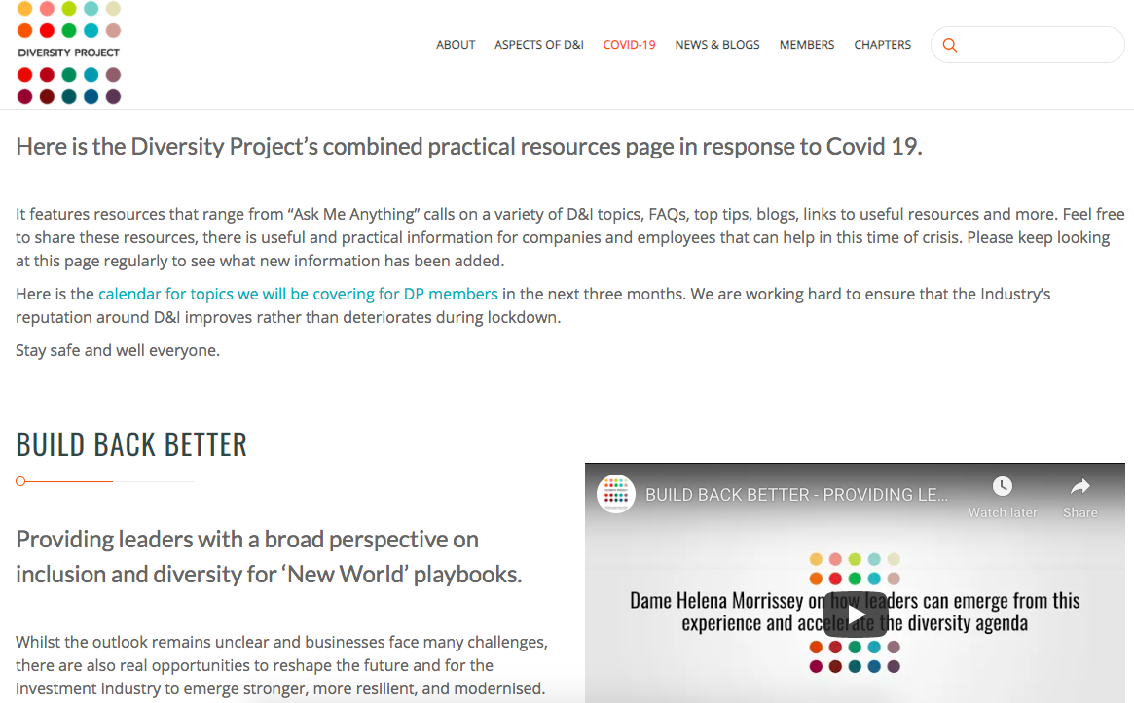
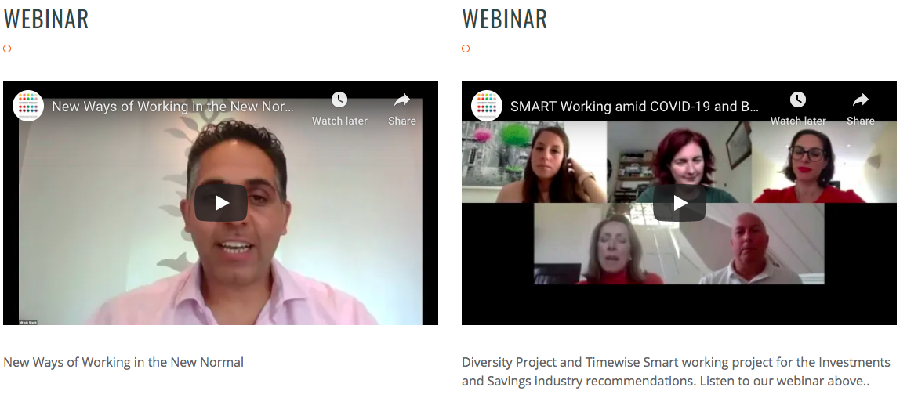
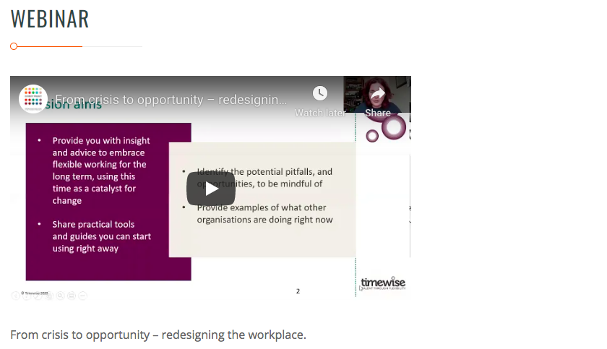
Covid – resources page

Slide 8
DP achievements 2020
Developing higher standards and collaboration
 | 10 Standards – 40 Self Assessment Forms
 | #TalkAboutBlack: #IAM webinar, #BHM webinar, CASP initiative and Mentoring circles
 | Relaunched workstream – two targets; 30% of fund mangers to be female and halve the gender pay gap by 2030
 | Ran Investment Springboard with UpReach; 100 students took part. Around half have been offered internships
 | Cross company returners programme pilot with Women Returners – originally 30 placements across six firms, but less due to Covid
Sharing best practice
Multiple guides developed and published, including;
Build Back Better compendium | SMART Working Manifesto
Why line management is critical to creating an inclusive culture | PLSA – Trustee diversity recruitment guide and 2020 Voting guidelines produced
#TAB – what actions companies and individuals can take to drive real change
Stronger focus on joining up and embedding efforts within firms

Slide 9
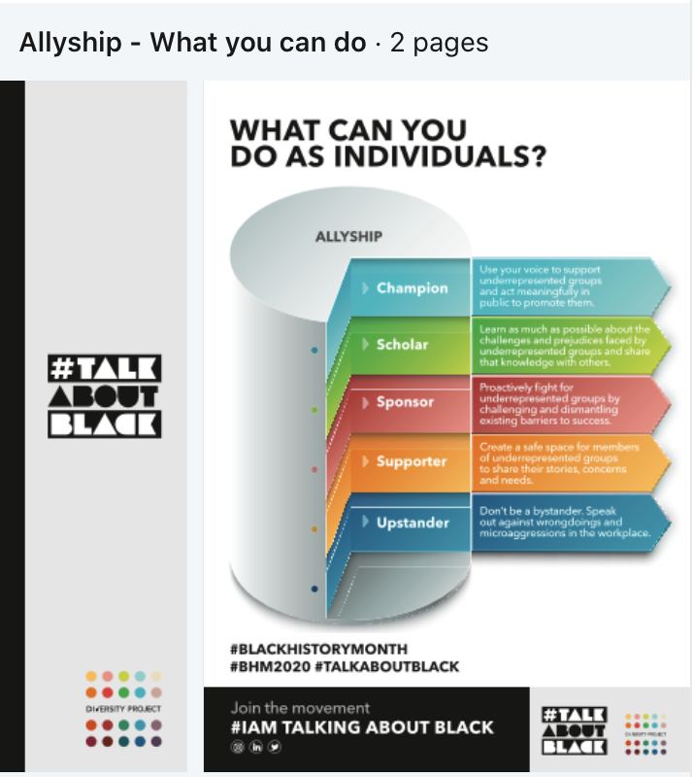
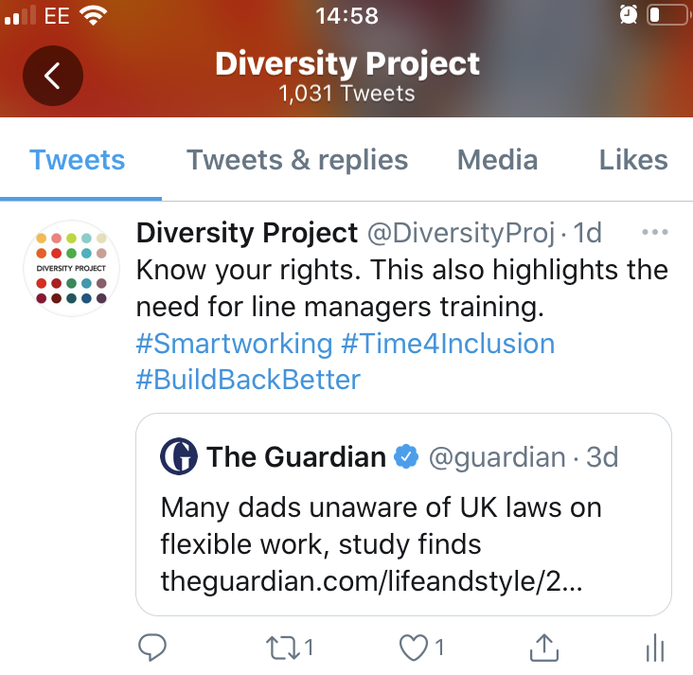
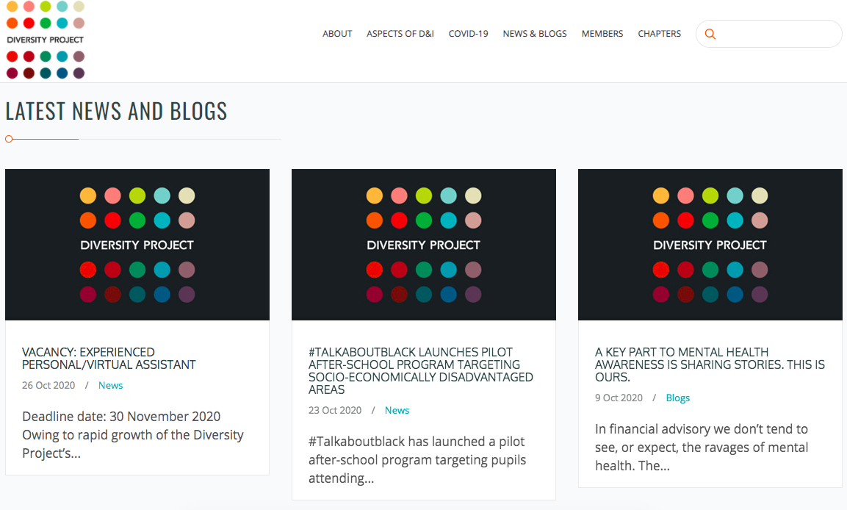
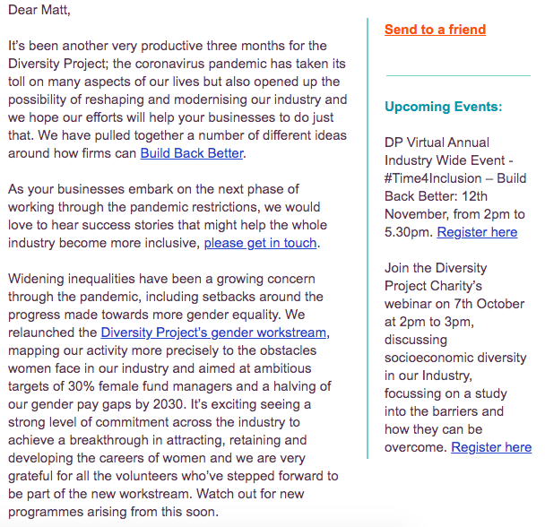
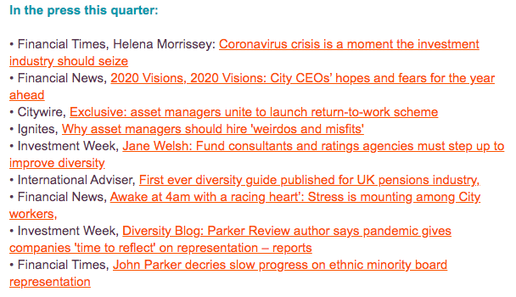
DP achievements 2020
Notes:
189 bits of information added to the DP website
370 social media posts on LinkedIn and Twitter
Just under 70 press releases and pieces of coverage
7 enewsletter

Slide 10
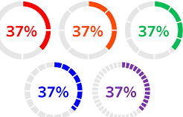
Our calls to action
Review and recommit to your diversity and inclusion strategy in the light of COVID
Find a way to collect and analyse diversity data to measure progress
Refresh your policies and programmes in the light of the first two points above
What will our Industry and our companies’ Covid legacy be?

