Slide 1
Gender: A fresh perspective
Helena Morrissey
Chair, Diversity Project

Slide 2
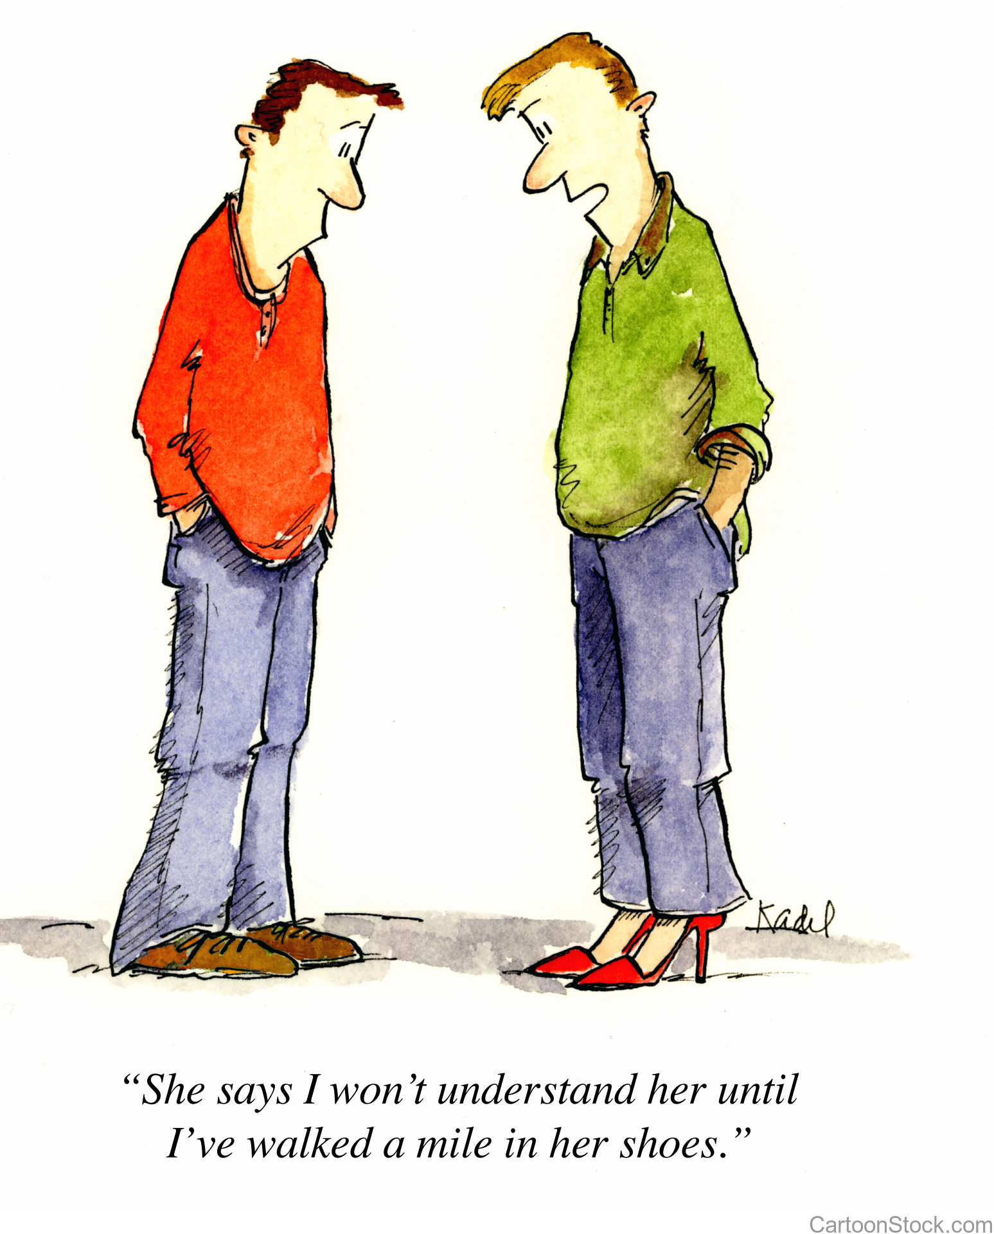

Slide 3
Main hurdles – gender diversity in asset management
Economic pressures
ATTRACTION
Industry reputation/ awareness
HR Policies – theory vs reality
Recruitment
processes
Metrics
Lack of tailoring to women’s
approaches and lives
CEO leadership: putting aspirations into practice throughout the organisation
RETENTION
Lack of role models
PROMOTION
/ PROGRESSION
Talent development
Lack of sponsorship
Culture
Building a network
Line manager behaviours
Opaque career progression paths
Lack of client insistence
Job design
Poor succession planning

Slide 4
30% of fund managers to be female
Our 2030 targets
halve the gender pay gap

Slide 5
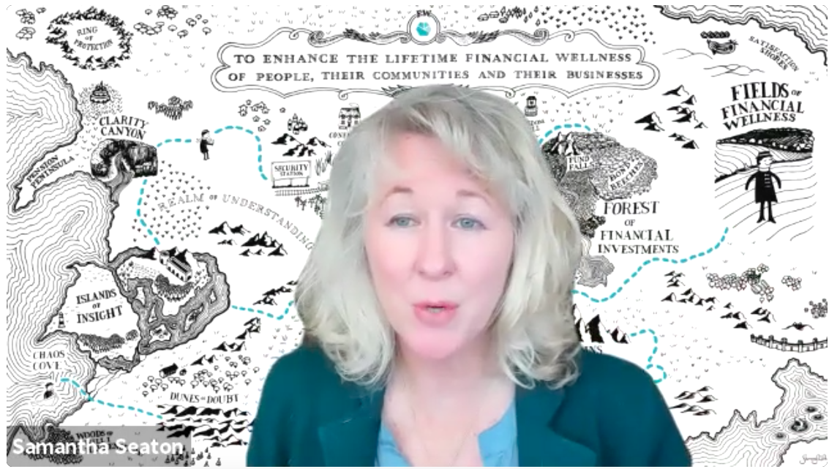
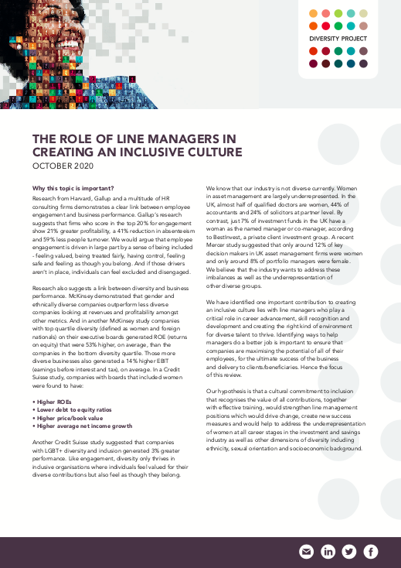
A fresh start, new resolve and updated actions
Women’s stories to inform and encourage: podcasts
Elevate the skill of good line management
Build understanding
Clear, measurable goals

Slide 6
Calls to action
Review and emphasise line management skills and their importance
Refresh your gender ambitions and plan
Provide the Diversity Project with data around numbers of female fund managers and the size of the whole team so we can create an accurate baseline
Covid need not be a setback for gender equality: resolve to create an opportunity

