Slide 1






Diversity Data – What, Why and How?
Matt Cameron, Global Managing Director
@MattJCam @LGBTGreat
matt@lgbtgreat.com @lgbtgreat

Slide 2




Who is LGBT Great?
A specialist organisation developing inclusion within the global investment and savings industry.
3 strategic pillars:
Insights
Visibility
Outreach
Required to become LGBT+ diverse and inclusive.
#Project1000 #RoleModels

Slide 3


Slide 4




Data is the ‘bedrock’ of business

Slide 5
What gets valued gets measured and what gets measured gets done.

Slide 6
“You have to measure what you want more of”.
Charles Coonradt, Founder of The Game Work

Slide 7
76% white men
4% of investing decisions made by women
The biggest gender pay gap
Only 1% of investment managers are black
Only 3% identify as LGBT+
40% LGBT+ say that ‘banter’ is their number one concern
63% of LGBT+ employees say that they don’t have any visible role models or allies

Slide 8


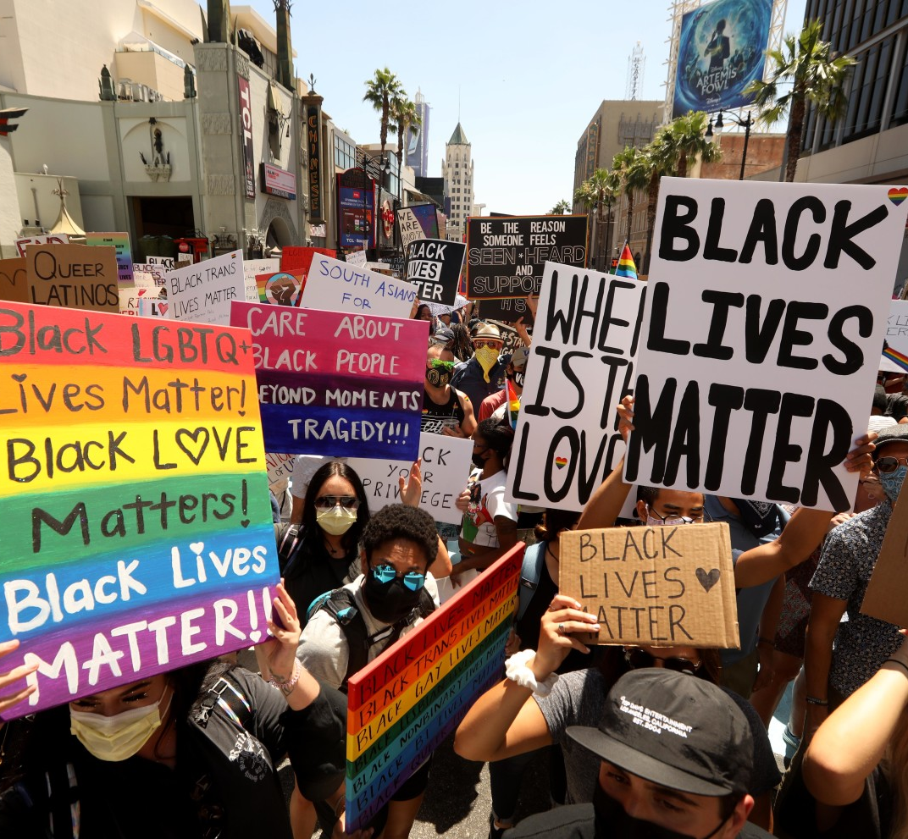
Optimal Timing
Work reimagined
Social injustice movements

Slide 9


Insights Research: Diversity Data
Overview and methodology
Data collection and reporting
Impact of COVID-19
LGBT Great diversity survey
Employee disclosures
D&I strategy and approach

Slide 10
Insights - diversity data survey:
Data collection and reporting
Nearly all organisations have a narrow focus on protected characteristics and collect data only during recruitment, with a majority not focusing on intersectionality
97%
Top five barriers to collecting D&I data in recruitment that organisations face
organisations collect data on gender and age, and do so only at the time of recruitment
Candidates prefer not to say
68%
Data protection
organisations do not analyse their data on intersectional identities
Legal constraints
67%
Trust
organisations do not collect pay reporting data on preferences other than gender
Opportunity to provide data

Slide 11
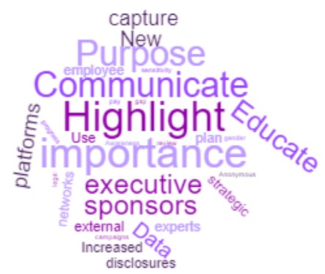
Insights - diversity data survey results:
Employee disclosures
Majority of organisations believe current levels of disclosure do not accurately represent their workforce and perceive lack of awareness as the leading barrier
73%
Key actions organisations are considering to address these potential barriers
of organisations believe that current levels of disclosure do not accurately represent their workforce
Top three perceived barriers to employees disclosing their data
Lack of awareness with regards to importance
Trust
Most of the organisations believe that educating employees, highlighting the importance and purpose of data collection, and communicating better are key actions to removing barriers to data disclosure
Confidentiality

Slide 12
Insights - diversity data survey results:
D&I strategy and approach
CEO’s of most organisations advocate diversity data collection although many organisations are at early phases of their D&I journey; gender is the most prioritised protected characteristic, followed by race and sexual orientation.
72%
% of organisations prioritising the following protected characteristics
organisations say they have their CEOs advocating and sponsoring diversity data collection
Gender
Race
88%
Sexual orientation
organisations think diversity representation targets are effective, yet
Disability
Pregnancy & maternity
53%
organisations believe that it’s too early in their D&I journey to comment on the effectiveness of focusing on one protected characteristic at a time
organisations do not participate in an LGBT+ D&I benchmark
53%

Slide 13
Insights - diversity data survey results:
Impact of COVID-19
Majority of respondents are considering the impact of D&I and are actively taking initiatives to mitigate risks while planning their phased return to work strategy
Top five considerations organisations are taking to mitigate D&I risks while returning to work
Caring responsibilities
65%
Workspace
Targeted pulse checks/ engagement activity
of the organisations have considered the impact of D&I within phased return to work
Individual data collection on preferences
Ease of access to office

Slide 14
2021: Thinking Ahead
Develop a vision of where you could be.
Leverage diversity data with purpose.
Role model leadership and inspirational stories.
Connect diversity data to the ESG agenda.

Slide 15


Diversity Data – Research Study
Join Our Consultation: matt@lgbtgreat.com
What has worked in you firm?
What could make a difference?

Slide 16

Diversity Data is Powerful.
www.lgbtgreat.com @lgbtgreat

