Slide 1
The Diversity Project
Helena morrissey – head of personal investing, LGIM

Slide 2
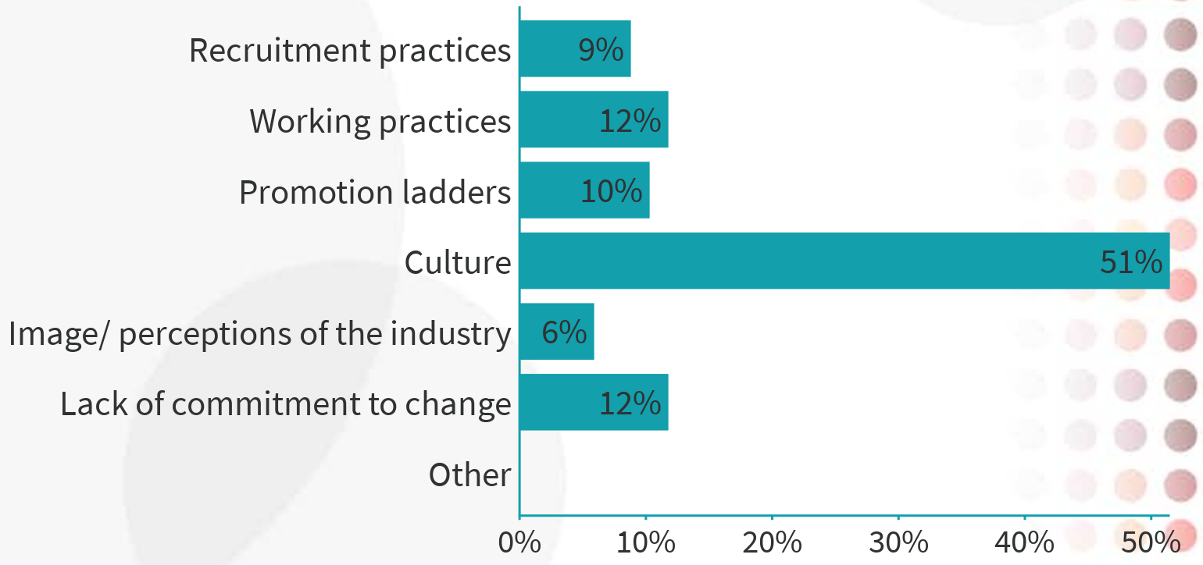
Audience question
What do you think is the single biggest impediment to greater progress on diversity in our industry?
1) Recruitment practices
2) Working practices
3) Promotion ladders
4) Culture
5) Image/ perceptions of the industry
6) Lack of commitment to change
7) Other

Slide 3
Broad participation across the industry – thank you!
Current members (as at 1 August 2018)
Aberdeen Standard
Allianz GI
Alpha FMC
Amundi
Aon Hewitt
Armstrong International
Aviva
AXA IM
BlackRock
BMO
Bruin
Brunel Pension Partnership
Carmignac
CFA Institute
CFA UK
Columbia Threadneedle
DWS
Fidelity
GAM
Goldman Sachs
HSBC Global Asset Management
HT Financial Marketing
Invesco
Investec
Investment Association
Investment2020
JanusHenderson
JLT
Jupiter
LCP
LGIM
M&G
Mercer
MFS
Murano
Northern Trust
Pension Insurance Corporation
PLSA
PWC
Quilter
Redington
Russell Investments
Schroders
State Street Global Advisors
The Buyside Club
The Ocean Partnership
T Rowe Price
Vanguard
Wellington
Willis Towers Watson
A joined-up, collaborative programme

Slide 4
Strong commitment from the Advisory Council (10 commitments now tracked by each firm)
Aberdeen Standard Andrew Laing/ Richard Charnock
AON Hewitt Tim Giles
Aviva Euan Munro
Blackrock Rachel Lord
Columbia Threadneedle Mark Burgess
HSBC Andy Clark
Invesco Andrew Schlossberg
The Investment Association Chris Cummings/ Jack Knight
JLT Mark McNulty
Jupiter Edward Bonham-Carter
LGIM Mark Zinkula
Mercer Fiona Dunsire
MFS Gaby Grougey
Murano Ole Rollag
Northern Trust Teresa Parker
Pension Insurance Corp Tracy Blackwell
PLSA Julian Mund
Quilter Paul Feeney
Redington Dawid Konotey-Ahulu
Russell Investments Joe Linhares
Schroders Peter Harrison
SSGA Cuan Coulter
Wellington Philip Perelmuter
Wiilis Towers Watson Ed Francis
Vanguard Sean Hagerty
Anne Richards

Slide 5
Leadership from the work stream leads/ co-leads
Early career
Shruti Khandekar
Ethnicity
Dawid Konotey-Ahulu
Gavin Lewis
HR
Kate Garner
Metrics
Sinead Clark
AC Farstad
Pension fund trustees, asset owners
Lesley Williams
Returners
Rachel Harris
Disability
Katy Halliday
Peter Slater
LGBT+
Colette Comerford
Smart Working
Samantha Lamb
Gender
Cosmo Elms
Jane Welsh
Working families
Emily McGuire
Neurodiversity
Meike Bliebenicht
Ambassadors’ programme
Sarah Bates,
Alexandra Haggard
Marketing
Linda Russheim
PR
Cicero
Project Management
Jane Welsh
A comprehensive set of initiatives
Key: yellow provide wide support for the DP, green are types of diversity and blue are career stages

Slide 6
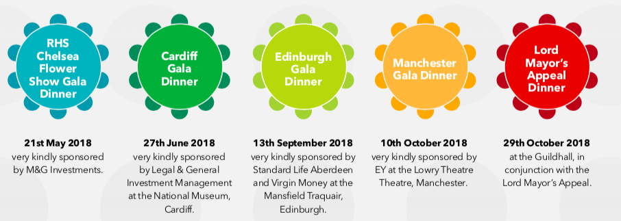
Wide participation in Diverse City charitable events

Slide 7
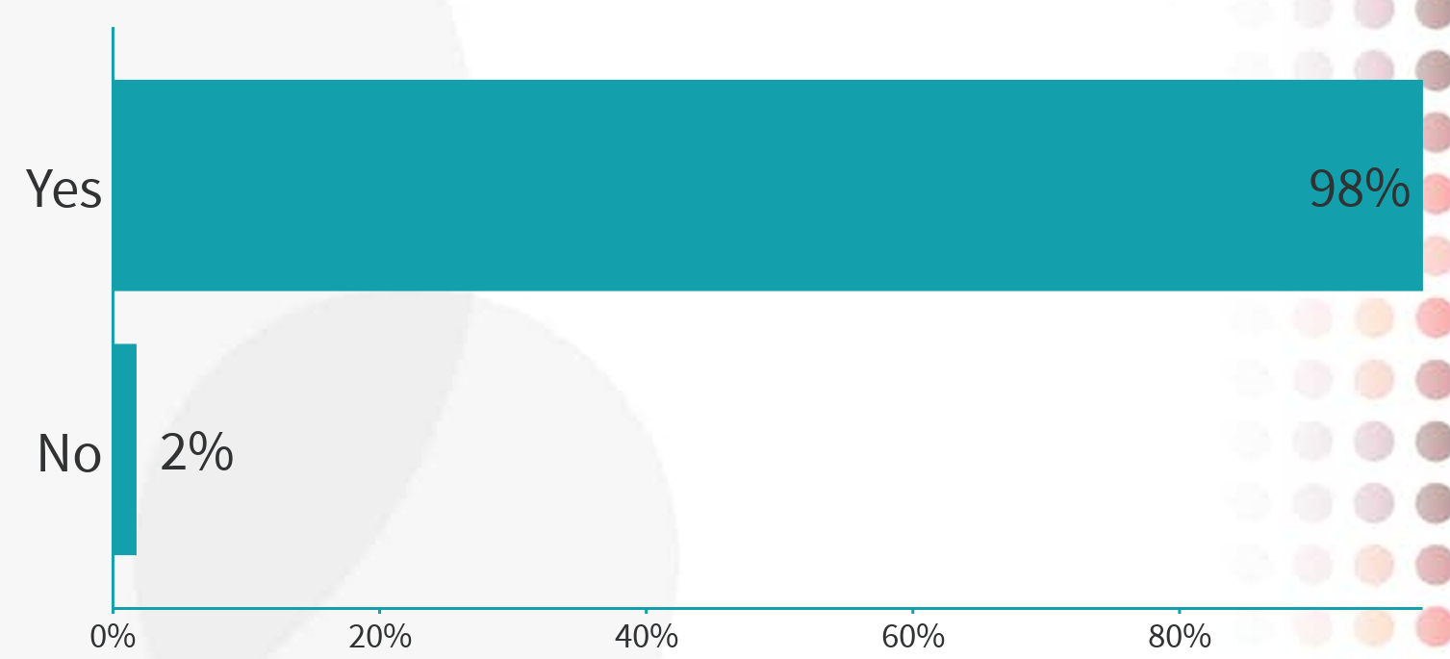
What is your view?
Diversity improves a company’s financial performance
A: YES
B: NO
VOTE NOW!

Slide 8
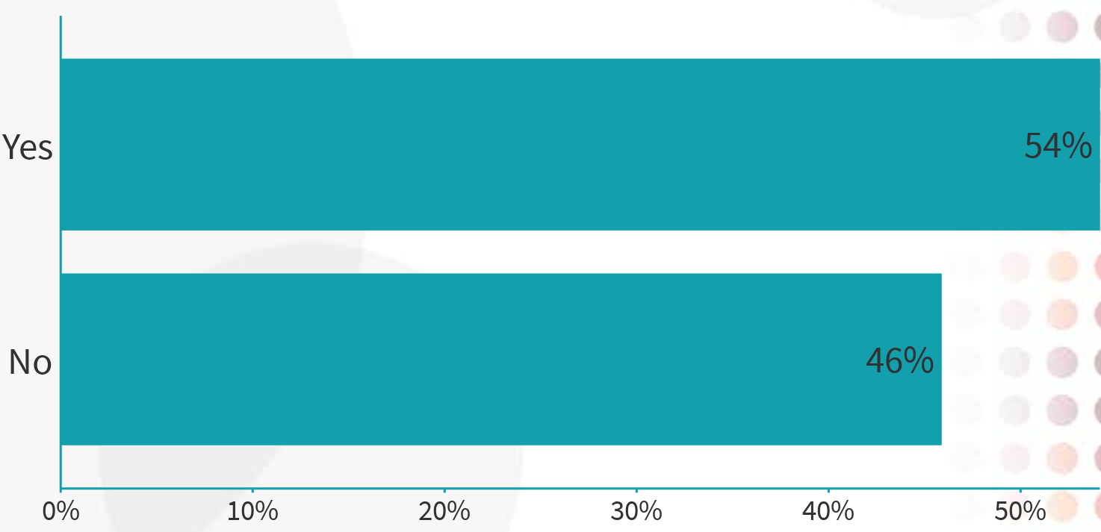
What do you do?
Q. I take diversity into account when analysing a company’s financial
prospects
A: YES
B: NO
VOTE NOW!

Slide 9
But…we have a mountain to climb
Our problem’s not ‘just’ gender but…
The gender pay gap data creates an additional hurdle/ incentive
Investment industry’s gender pay gap is extreme:
28.5% average salary gap
55.4% average bonus gap
30% Club Future Aspiration study: women feel they have less opportunity to fulfil their career potential in male-dominated sectors
Citywire Alpha Female 2018 report shows benefit of mixed gender teams

Slide 10
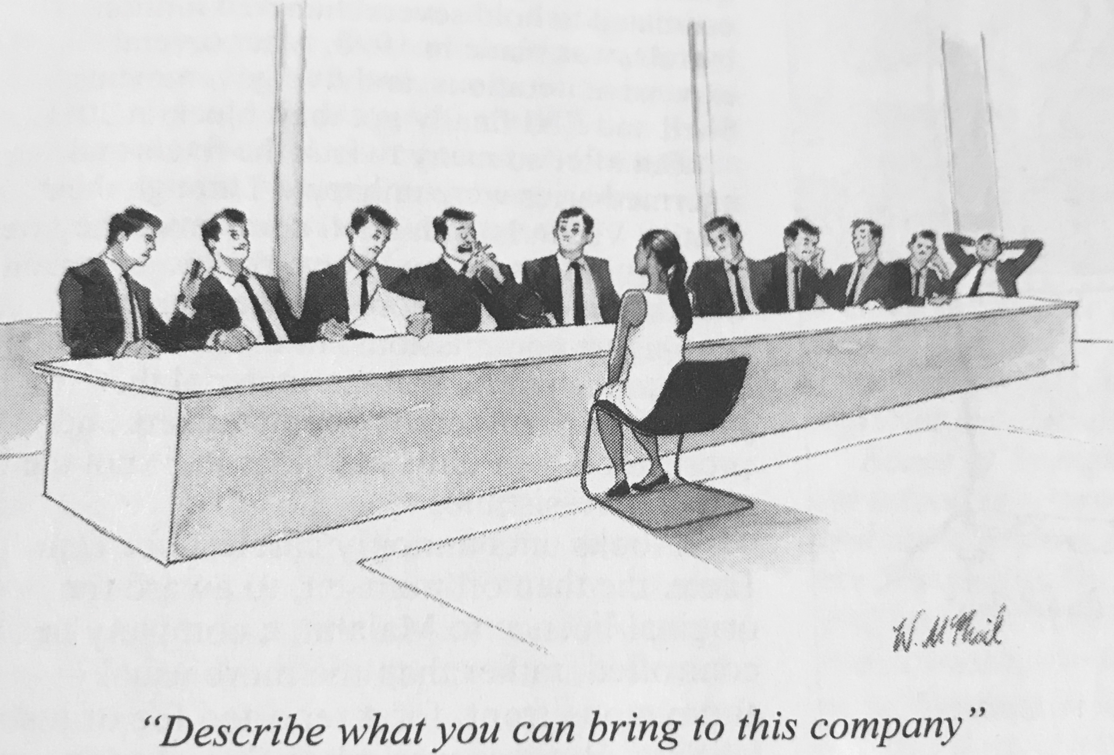

Slide 11
Why Diversity Programmes Disappoint
On the periphery, not the main event
The under-represented are talking to each other
Mandatory unconscious bias training – NO!
Think Andy Haldane’s Recruitment Challenge
We need to overhaul our ways of working, recruiting, promoting, managing, rewarding, celebrating talent

Slide 12
We need a greater sense of urgency
Diversity still treated as a special interest issue
Stuck in ‘early mind-set’ - focused on identity and experiential diversity
Time to develop a more sophisticated approach, with bolder ambition
Not adapting, but re-thinking
The prize is great! Let’s create a new generation of exciting investment talent together

